Slide 1


Provision devices at scale
Pamela Cortez |
Hardware Ecosystem Engagements & Communities Senior PM, Azure IoT
@AltaOhms
/in/pamelacortezhellotechie

Slide 2
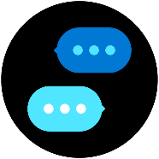
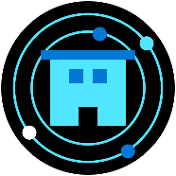
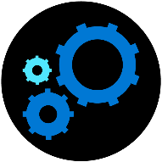


Build end to end IoT Solutions
Transform your business with IoT
Connect devices to the cloud
Provision devices at scale
Understand IoT message processing, analytics, and business integration
Build the intelligent edge
Build IoT solutions with Azure IoT Central
Notes:
Transform your business with IoT
To start this series, we’ll explain how the Internet of Things (IoT) addresses the problems of efficiency, productivity, safety, and security. We’ll describe Azure IoT components and explain how you combine them to create value for enterprises, enabling digital feedback loops for solutions that extend beyond telemetry with analytics and edge solutions that provide real-time status.
Create an Azure dashboard and resource group.
Create an IoT hub using the Azure portal.
Examine features of Azure IoT Hub.
Create a device provisioning service and link it to your IoT hub.
Connect devices to the cloud
In this session, you’ll learn how to set up the development environment used throughout this series. We’ll cover how to connect an IoT device that includes temperature and humidity sensors to Azure. In the labs, you’ll configure a simulated device to connect to Azure IoT Hub. Then you’ll run the simulated device to send telemetry messages and verify that device telemetry is being received.
Provision devices at Scale
This portion of the workshop walks through a hypothetical asset-monitoring solution that requires IoT devices with sensors for tracking location, temperature, and pressure to be placed in product transport boxes. When a new box enters the system, it is equipped with the new IoT device. The device needs to be autoprovisioned to the IoT hub using Azure’s device provisioning service. When the box arrives, the sensor is removed from the box and needs to be “decommissioned” through the device provisioning service. You’ll learn how you can use the device provisioning service to enroll many devices automatically and securely using X.509 certificate authentication.
Understand IoT message processing analytics and business integration
Preventive maintenance is a key IoT scenario—detect that something is wrong before there is any damage. In this module, you’ll write code to send continuous telemetry to an IoT hub that will use Azure Stream Analytics and a built-in machine learning model to warn of anomalies. Using Power BI to visualize the data stream, you’ll create an event subscription within Azure IoT Hub to set up Azure Event Grid integration that will trigger a logic app to send an alert. We’ll also cover working with time series data using Azure Time Series Insights.
Build the intelligent edge
With the collection of large amounts of data and the need for urgent responses, you’ll want to bring the intelligence to the edge for processing data and only send the important data to the cloud. We’ll take a deep dive on using an Azure IoT Edge device as a gateway and you’ll learn the different scenarios where an IoT Edge device is on an enterprise network (needs proxy settings) or needs extended offline capabilities.
Build solutions with IoT Central
Designed to enable the easy monitoring and management of a fleet of devices, Azure IoT Central encompasses a range of underlying technologies that work together well but can be complicated to implement when many technologies are needed. These technologies include Azure IoT Hub, the Azure device provisioning service, Azure Maps, and others. We’ll also take a look at IoT Plug and Play to interact with a device's capabilities even without knowledge of the underlying device implementation.

Slide 3
Agenda
Overview of Device Lifecycle & Device Provisioning Service
Scenarios
How it works
Lab: Provision IoT devices securely and at scale with Device Provisioning Service
Create DPS resource & group enrollment. Provision device with x.509 certificate attestation
Send Device Telemetry to IoT Hub
Deprovision
Developer Resources & Getting started

Slide 4
IoT Solution Architecture
THINGS
INSIGHTS
ACTION
Gain real time insights and improve business processes
Identify patterns in data, automate rules & alerts
Optimize operations, increase profitability, & create more compelling business models
IoT Devices
Custom
Cloud Gateways
Custom
Protocols
UI & reporting Tools
Configure and control
Visualize data and learnings
Constrained Devices
Field Gateways
Constrained Devices
Cloud Gateway (IoT Hub & Device Provisioning Service)
Stream Processing
Business Integration
Stream processing and
rules evaluations over data
Edge Devices
Intelligent
Edge
Edge Devices
Data Transformation
Machine Learning
Storage
Cold
Path store
Warm
Path store
IoT Devices
IP Capable devices
send data from devices to Cloud
Store data
Integrate with Business process
Notes:
Device provisioning. For registering and connecting large sets of devices, we recommend using the IoT Hub Device Provisioning Service (DPS). DPS lets you assign and register devices to specific Azure IoT Hub endpoints at scale.
Quick recap from the Deciphering Data Introduction session
Things :
Directly connected, via a gateway, or intelligent edge devices
If you are a device developer you need to be thinking about message types, data types, serialisation, and metadata as these simply data processing in the cloud.
Insights
Stream processing, data transformation, and Storing
Remember to consider the volume and value of data as this will guide you as to where you are storing data
Actions
Integration with business systems
Make better business decision based on data
Opportunities to automate
Batch analytics and training machine learning

Slide 5




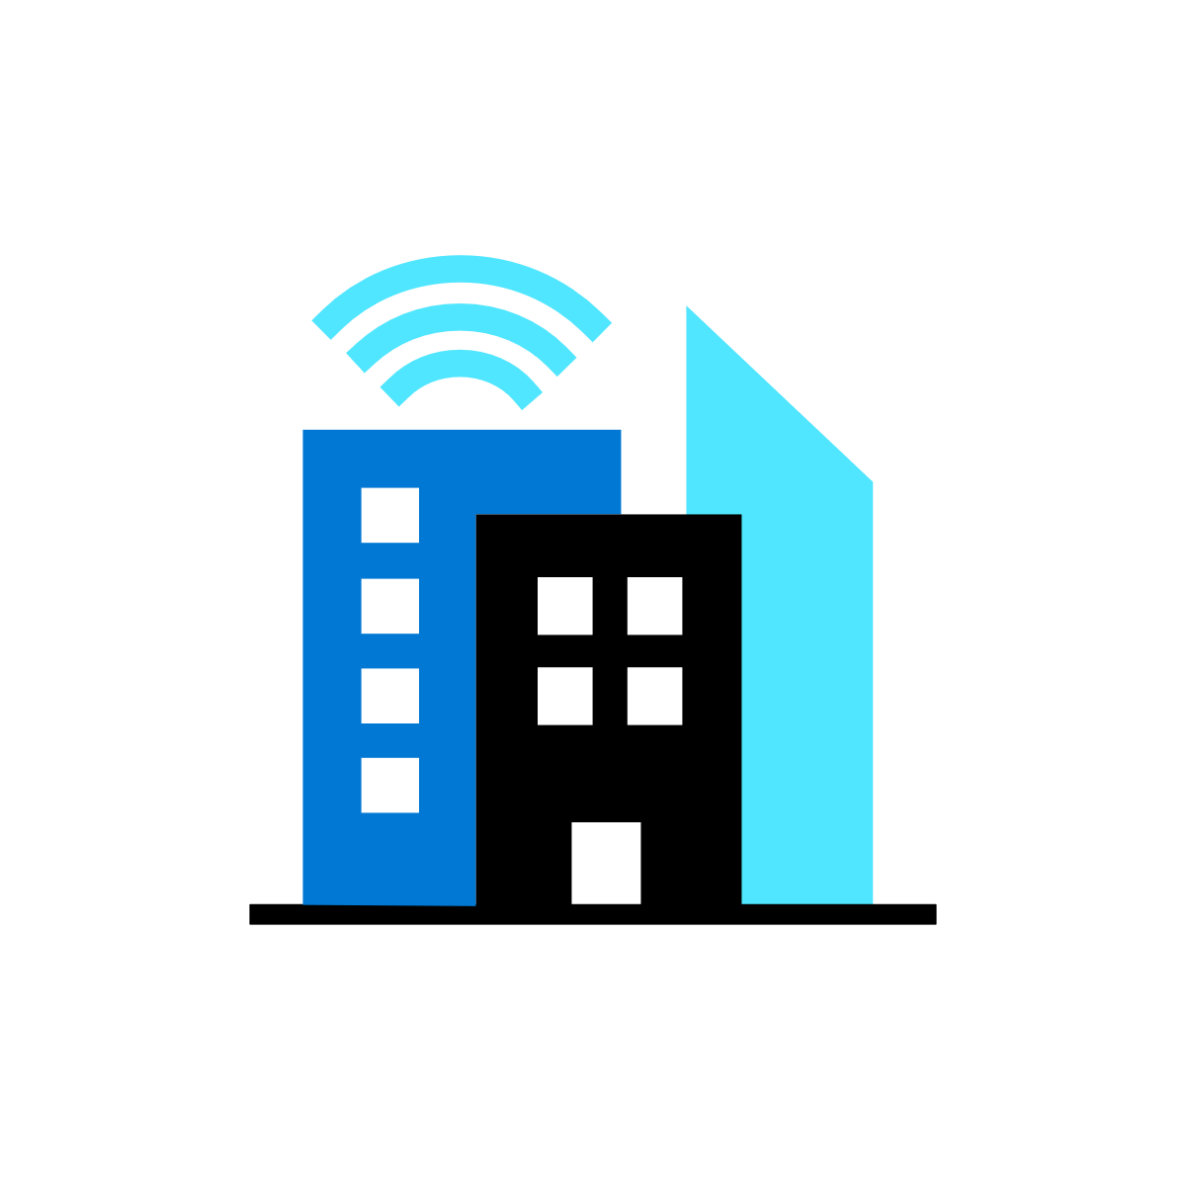

Microsoft’s comprehensive IoT product portfolio
→ aka.ms/mslearniot
Azure IoT priority verticals
Manufacturing | Retail | Agriculture | Energy | Smart Cities | Healthcare | Transportation
Azure IoT Central
(SaaS)
Azure IoT Reference Architecture & Accelerators (PaaS)
Dynamics Connected
Field Service
(SaaS)
Azure IoT Solutions
Azure IoT Hub
Azure IoT Hub Device Provisioning Service
Azure Digital Twins
Azure Time Series Insights
Azure Maps
Azure Stream Analytics
Azure Cosmos DB
Azure AI
Azure Cognitive Services
Azure ML
Azure Logic Apps
Azure Active Directory
Azure Monitor
Azure DevOps
Power BI
Azure Data Share
Azure Spatial Anchors
Azure Defender
for IoT
Azure Services for IoT
Azure RTOS
Azure Sphere
Azure IoT Device SDK
Azure IoT Edge
Azure Stack Edge
Windows IoT
Azure Certified for IoT—Device Catalog
Azure Stream Analytics
Azure Storage
Azure ML
Azure SQL
Azure Functions
Azure Cognitive Services
IoT & Edge
Device Support
Notes:
Our foundational technology investments are the underpinning for all of this.
Simply building IoT solutions and reducing the complexity of building end to end solutions. Plus connect to the rest of your business.
We have products and services for both the device and cloud side. Plus, products with Azure IoT Central to help you build an IoT solution quickly without the need of any cloud solution development skills required.

Slide 6



Develop with choice
Digital Twins
Azure IoT Central
Azure IoT Hub
The easiest and most cost-effective way to connect and manage devices at scale, and time to results.
Enable highly secure, flexible and reliable communication from the cloud to the edge.
Create comprehensive digital models of entire environments.³
1000+ Azure IoT Devices certified¹
150 billion messages per month via IoT Hub²
Gartner includes Microsoft as a Digital-Twin-Enabled Application Provider³
1 Placeholder Source; 2 Placeholder Source; 3 Gartner: Market Guide for Digital Twin Portfolios and Enabling Technologies (Jan 2020)
Notes:
Azure IoT Central is the easiest and most cost-effective way to connect and manage devices at scale. It connects your IoT devices to the cloud faster than any other platform. You can find new devices matched to your solution in the Azure Certified for IoT device catalog. Also, we understand how hard it is to keep devices connected and healthy. Azure IoT Central lets you reconfigure and update devices with centralized device management. In addition, the connectors and extensibility APIs bridge the gap between your business applications and IoT solution.
Azure IoT Hub is a Platform as a Service. With it you can do the following:
Establish bi-directional communication with billions of IoT devices
Enhance security with per device authentication
Provision devices at scale with IoT Hub Device Provisioning Service
Manage devices at scale with device management
Use multi-language and open source SDKs
A Digital Twin (DT) is a dynamic digital representation of a physical piece of equipment, or thing, and its associated environment. Every DT has a dynamic data model containing only a few, or even thousands, of data attributes of the physical thing or system it represents. Attributes are associated with sensors that are measuring temperature, pressure, and other variables and associated physics in order to represent real-world operating conditions as well as static values like the installation date or OEM. Azure Digital Twins is the development platform for IoT solutions that model the real world.

Slide 7


IoT Hub and Device Provisioning Service
Device Provisioning Service
Azure IoT Hub
Bi-directional communication
Enterprise scale & integration
End-to-end security
IoT-scale automated provisioning
Millions of Devices
Multi-language, open source SDKs
HTTPS/AMQPS/MQTTS
Send Telemetry
Receive Commands
Device Management
Device Twins
Queries & Jobs
Billions of messages
Scale up and down
Declarative Message Routes
File Upload
WebSockets & Multiplexing
Azure Monitor
Azure Resource Health
Configuration Management
Per Device Certificates
Per Device Enable/Disable
TLS Security
X.509 Support
IP Whitelisting/Blacklisting
Shared Access Polices
Firmware/Software Updates
Azure Defender Support
Zero-touch provisioning
Centralize your provisioning workflow
Load balance across multiple IoT Hubs
Re-provisioning support
Supports TPM + X.509
Notes:
Per device authentication

Slide 8
Biggest challenges with devices
Open source SDKs
IoT Hub
Device Provisioning Service
Developing and maintaining a connected,
secure, serviceable and supportable device
Integrating devices and their data into cloud services
Out-of-the-box provisioning of devices at scale
But what about device management over the long-term?

Slide 9
IoT Device Management Lifecycle
Replace or decommission devices after failure, upgrade cycle or service lifetime
Group devices and control access according to your organization's needs
Retire
Plan
Monitor device inventory, health and security while providing proactive remediation of issues
Securely authenticate devices, on-board for management and provision for service
Monitor
Provision
Configure
Provide updates, configuration and applications to assign the purpose of each device

Slide 10
Why provisioning is hard today?
Solutions must have per-device revocable access
Provisioning is a manual process
Initial configuration can become irrelevant between manufacturing and deployment
Device supply chains are complex

Slide 11
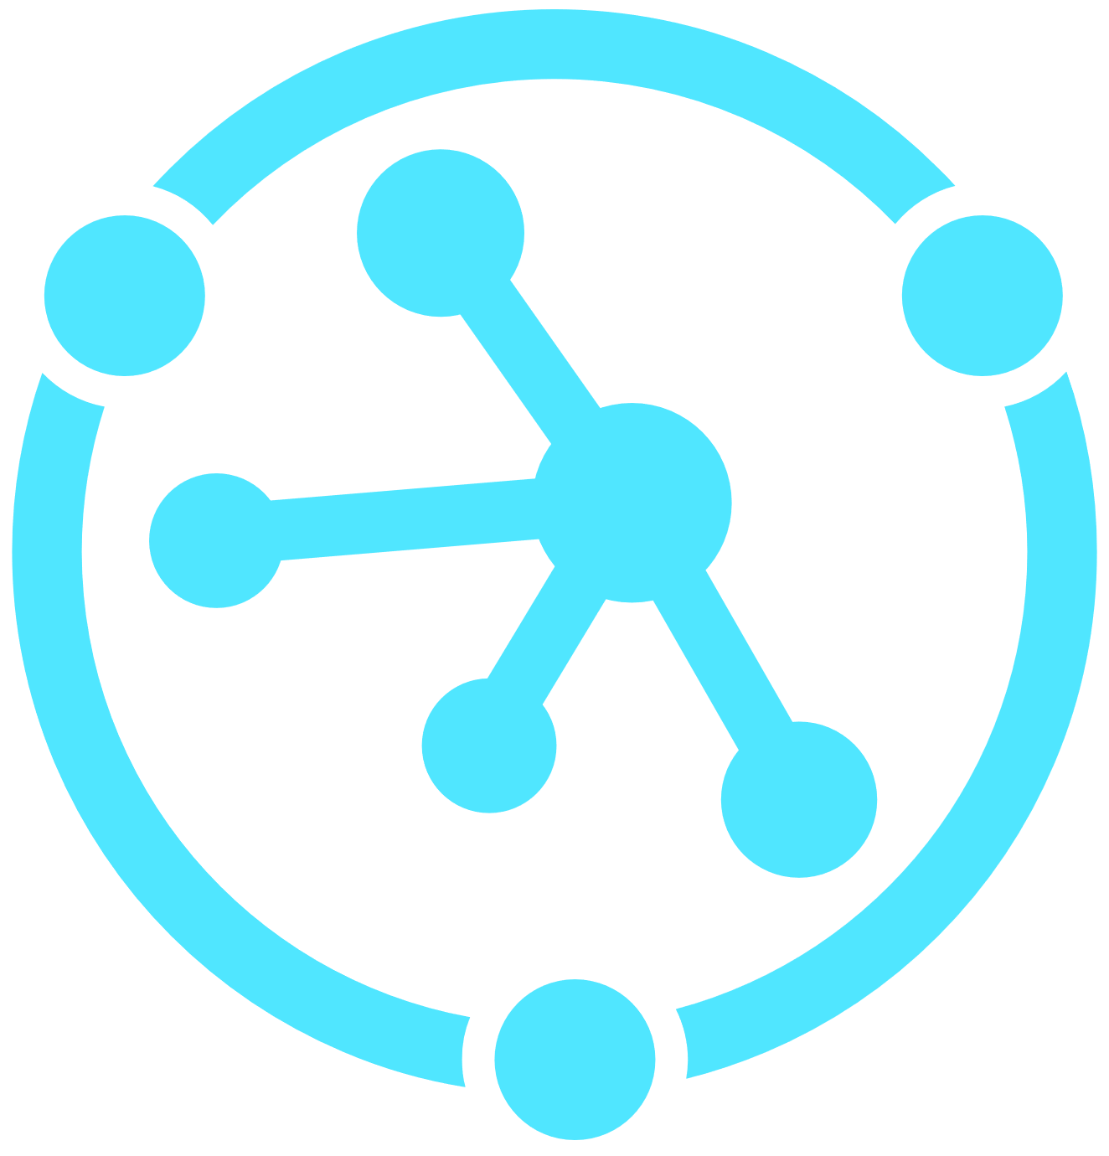
Device Provisioning Service (DPS) brief feature overview
Cross-region, cross-subscription DPS→IoT Hub support for geo-sharded and multitenancy solutions
Automatic re-provisioning supports the device lifecycle
Factory reset
Migration
Flexible, targeted device assignment logic
Static assignment for when you know the hub
Evenly weighted for round-robin assignment
Lowest-latency for geo-shared applications
Custom assignment logic for advanced scenarios
Manage devices at as a group or as individuals
Based on authentication type
Multiple auth methods supported
Symmetric keys for getting started
TPM endorsement key for secure storage
X.509 certificates for maximum security
Cross-platform support through open-source SDKs
Edge device support
Notes:
Secure attestation support for both X.509 and TPM-based identities.
Enrollment list containing the complete record of devices/groups of devices that may at some point register. The enrollment list contains information about the desired configuration of the device once it registers, and it can be updated at any time.
Multiple allocation policies to control how DPS assigns devices to IoT hubs in support of your scenarios: Lowest latency, evenly weighted distribution (default), and static configuration via the enrollment list. Latency is determined using the same method as Traffic Manager.
Monitoring and diagnostics logging to make sure everything is working properly.
Multi-hub support allows DPS to assign devices to more than one IoT hub. DPS can talk to hubs across multiple Azure subscriptions.
Cross-region support allows DPS to assign devices to IoT hubs in other regions.
Encryption for data at rest allows data in DPS to be encrypted and decrypted transparently using 256-bit AES encryption, one of the strongest block ciphers available, and is FIPS 140-2 compliant.
Lowest latency: This policy assigns devices to the linked IoT Hub which will result in the lowest latency communications between device and IoT Hub.
Evenly weighted distribution: This policy evenly distributes devices across the linked IoT Hubs. If you are provisioning devices to only one IoT Hub, we recommend this setting. The default setting.
Static configuration: This policy requires a desired IoT Hub be listed in the enrollment entry for a device to be provisioned.
Cross platform:
Just like all Azure IoT services, DPS works cross-platform with a variety of operating systems. Azure offers open-source SDKs in a variety of languages to facilitate connecting devices and managing the service. DPS supports the following protocols for connecting devices:
HTTPS
AMQP
AMQP over web sockets
MQTT
MQTT over web sockets
DPS only supports HTTPS connections for service operations.

Slide 12
A Selection of Scenarios
Initial connection
Load balancing
Ownership based
Location based
Re-provisioning
Zero-touch provisioning to a single IoT solution
Across multiple hubs
Connecting devices to their owner’s IoT solution based on sales transaction data
Connecting a device to the IoT hub with the lowest latency
Based on a change in the device, e.g. change of ownership
Notes:
There are many more scenarios the DPS supports than what’s listed on this slide, but this list should give you a taste for the variety of scenarios the DPS can be used for.
First bootstrapping devices to IoT Hub in a single IoT solution is definitely a scenario the DPS can be used for.
Load balancing is one of the simplest multi-hub scenarios to think about. Devices are allocated to different hubs to make management easier.
Ownership based: multitenancy solutions. If you sell widgets to multiple customers, you want to have data isolation. Want to make sure the devices are connected to the hub for the customer who purchased them.
Geolocation based: AKA geosharding. Want the device to connect to the IoT solution geographically closest to it.
Re-provisioning: one of the most important scenarios, and one that happens later in the device’s lifecycle. Re-provisioning could occur because the device was sold to another user, for example in the case of the lease. The device might have moved because it’s a vehicle and now needs to connect to a different region. Or, and this gets back to the security aspect, maybe the device is installed in a sensitive location and policy dictates that the device needs to re-attest (re-delare) its identity every 90 days, or 30 days, or even daily.

Slide 13


What is Provisioning?
Provisioning Setup = Pre-registration + Device Assignment
Device Provisioning = Runtime assignment + Initial Set up
Notes:
Let’s jump into how to Provision millions of devices using DPS.
What does “provisioning.” mean? In general, provisioning devices is a two part process. The first part is called a provisioning set up which requires a human operator to pre-register the device in the IoT solution so the IoT solution knows that the device exists. In addition, the human operator can also add some initial configuration for the devices. The human operator also need to program the device to its target IoT solution.
The second part when the device turns on (For example when a device is connected to wifi) and establishes a connection to the IoT solution where the device need to prove it is indeed the device the human operator has registered previously. Once the device is authenticated, it can go through some runtime assignments as well as gather some set up process.
Only when both of these steps are complete, then the device has been fully provisioned.
Manufacturing step
This step is all about what happens on the manufacturing line. The roles involved in this step include silicon designer, silicon manufacturer, integrator and/or the end manufacturer of the device. This step is concerned with creating the hardware itself.
DPS does not introduce a new step in the manufacturing process; rather, it ties into the existing step that installs the initial software and (ideally) the HSM on the device. Instead of creating a device ID in this step, the device is programmed with the provisioning service information, enabling it to call the provisioning service to get its connection info/IoT solution assignment when it is switched on.
Also in this step, the manufacturer supplies the device deployer/operator with identifying key information. Supplying that information could be as simple as confirming that all devices have an X.509 certificate generated from a signing certificate provided by the device deployer/operator, or as complicated as extracting the public portion of a TPM endorsement key from each TPM device. These services are offered by many silicon manufacturers today.
Cloud setup step
This step is about configuring the cloud for proper automatic provisioning. Generally there are two types of users involved in the cloud setup step: someone who knows how devices need to be initially set up (a device operator), and someone else who knows how devices are to be split among the IoT hubs (a solution operator).
There is a one-time initial setup of the provisioning that must occur, which is usually handled by the solution operator. Once the provisioning service is configured, it does not have to be modified unless the use case changes.
After the service has been configured for automatic provisioning, it must be prepared to enroll devices. This step is done by the device operator, who knows the desired configuration of the device(s) and is in charge of making sure the provisioning service can properly attest to the device's identity when it comes looking for its IoT hub. The device operator takes the identifying key information from the manufacturer and adds it to the enrollment list. There can be subsequent updates to the enrollment list as new entries are added or existing entries are updated with the latest information about the devices.

Slide 14
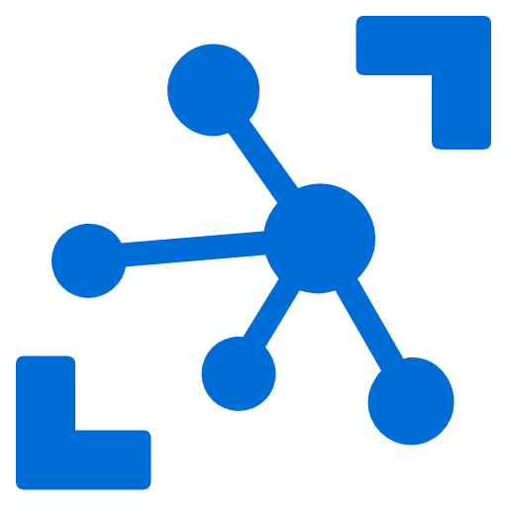
Provision Challenges
Connection String 3
Connection String 1
Connection String 2
IoT Devices
IoT Hub
Notes:
The process in the example is relatively simple and you can easily automate it all through scripts. However what if you expand the scope a little bit?
What if you have multiple IoT Devices that you want to assign to an IoT Solution? You would need to assign each individual devices the IoT Hub Connection String. This is also relatively easy when you have one IoT Hub as you can add this information into the device at the time of manufacturing.
Expanding a little more, you want to add new IoT Devices to a new IoT Hub, it’s getting harder because you need to keep track of multiple devices and IoT hubs and where they are assigned.
Finally, what if you want to assign an existing device to a new IoT Hub, this is especially difficult because the human operator would have to program the device because each IoT Hub has a unique endpoint. This last example is also not always feasible because IoT devices may be already be deployed and installed and reconfiguration is very difficult
To summarize, provisioning can be a very tedious and manual process as you add new devices or expand your iot backend. And initial device assignment may need to change once the device has successfully provisioned.

Slide 15

IoT Hub Device Provisioning Service
A helper service for IoT Hub that enables zero-touch, just-in-time provisioning to the right IoT hub without requiring human intervention.
IoT Devices
IoT Hub Device Provisioning Service
IoT Hub
Notes:
To mitigate some of the challenges mentioned, IoT Hub Device Provisioning Service that can simplify the provisioning setup and also allow for late assignment of IoT Devices to IoT hubs
after the device is connected

Slide 16
Provisioning with IoT Hub Device Provisioning Service
Pre-register device enrollment info
IoT Hub
Register new device, populate initial config
IoT Hub
Device Provisioning Service
IoT Hub Connection String
IoT Hub
IoT Hub
Business logic
IoT Hub Connection String
Device authentication
IoT Hub
Device telemetry
“where do I go”
Device telemetry
Establish connection
Device
Initial configuration
…etc
Insights
Notes:
Let’s go over how provisioning works with a device provisions via IoT Hub Device Provisioning Service . Only one IoT hub will shown for clarity, but the process works with up to 10 hubs linked to a single DPS
[each numbered point is a literal click stop]
After the device is manufactured, the device enrollment information is added to the DPS. This is the only manual step in the process as part of the provisioning set-up
At some point afterwards, which could be a day or it could be several months, the device goes online and connects to DPS to find its IoT solution home.
DPS and the device go through an authentication handshake using the device identity info. DPS verifies the device’s identity
DPS registers the device to IoT hub and populates the initial desired device state
IoT hub returns IH connection info for the device
DPS gives the device its IoT Hub connection info
The device now establishes a connection with IoT hub…
…and retrieves its initial config from IoT hub and makes any changes/updates, as needed
The device starts sending telemetry to IoT hub
The telemetry is consumed by the backend business logic
The business logic produces insights which are transformed into commands to the device to operate more efficiently
The telemetry/insights loop continues for the rest of the device’s useful life

Slide 17
Re-Provisioning at Scale
IoT Hub
East US
Device
Provisioning request
Devices assigned to IoT Hub East US
Change devices assignments to IoT Hub West US
Device
IoT Hub
West US
Device
IoT Hub
East Europe
Device
Device
IoT Hub
West Europe
……millions
Notes:
Millions of device can connect to the global endpoint of the Azure IoT Hub Device Provision Service and be assigned to the correct IoT Hub. But If the devices need to change to another IoT Hub, an example could be when devices are sold to another user and now the devices need to connect to another region. IoT Hub device provisioning service can do all of this with one simple Iot Hub assignment change and allow the devices to sent out a new provision request to fetch the new IoT hub information. This is just a quick demonstration on how re-provisioning works. Devices can reconnect to IoT Hub Device Provisioning Service with a new provisioning request to get reassigned to a new IoT Hub without changing any device code

Slide 18
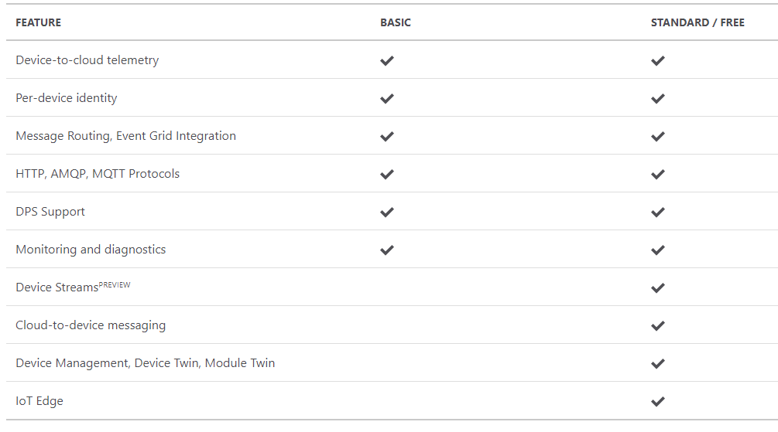
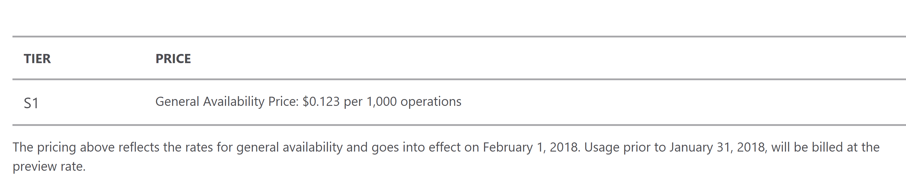
IoT Hub & Device Provisioning Service Support
Azure IoT Hub
Easy upgrade from basic to standard tier.
Only standard allows cloud-to-device commands, device twin operations and IoT Edge
Learn about IoT Hub scaling
Device Provisioning Service
Notes:
Before we jump into the dev tools and the lab, let’s discuss tier
IoT Hub Device Provisioning Service is billed by the number of operations. Operations include device registrations and re-registrations; operations also include service-side changes such as adding enrollment list entries, updating enrollment list entries and get/query operations. Every six months of inactivity on a given enrollment entry will incur a "keep-alive" operation.

Slide 19
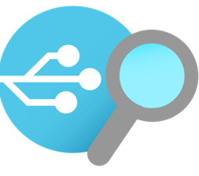
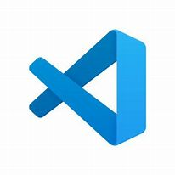
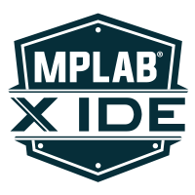





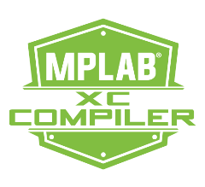
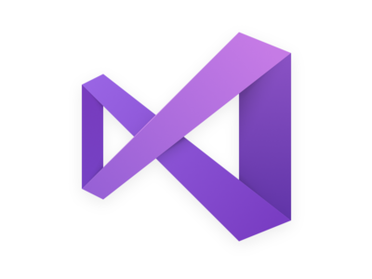

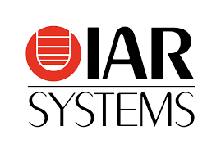
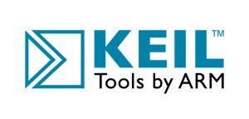





Simplifying IoT with developer tools
Azure IoT Explorer
Graphical tool for interacting with and testing your IoT devices
VS Code
Azure IoT Tools Extension Pack
Visual Studio
Azure IoT Hub & IoT Edge Support
Azure IoT CLI extension
Open-source cross platform command-line tool for managing Azure resources such as IoT Hub
Vendor Tooling
Samples with Azure RTOS, Embedded C SDK, IoT Plug and Play

Slide 20

Demo: Cheese Cave Provisioning devices to monitor and control temperature & humidity
https://aka.ms/get-started-azure-2021
https://aka.ms/get-started-azure-2021
THINGS
INSIGHTS
ACTION
Gain real time insights and improve business processes
Identify patterns in data, automate rules & alerts
Optimize operations, increase profitability, & create more compelling business models
IoT Devices Adding devices to monitor Cheese Caves
across different factories
IoT Hub Device Provisioning Service
IoT Hub
Action
Decision to retire and replace certain devices
Insights
Long term data collected shows device is no longer performing as desired

Slide 21
Resources
Notes:
ELP videos/presentation decks, MS Learn and Learn Paths, Instructor Led Training options, AZ220 Study Guide blog, IoT Demo GitHub and ultimately encouraging people to sign up for the 30 Days to Learn it challenge to earn 50% off the certification.

Slide 22
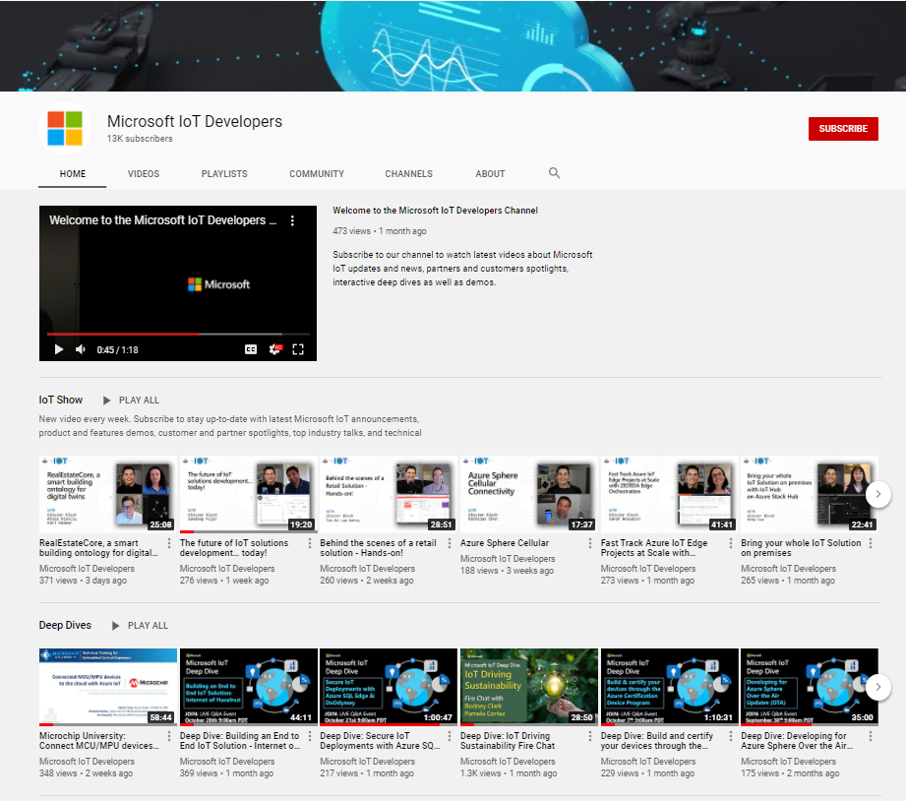
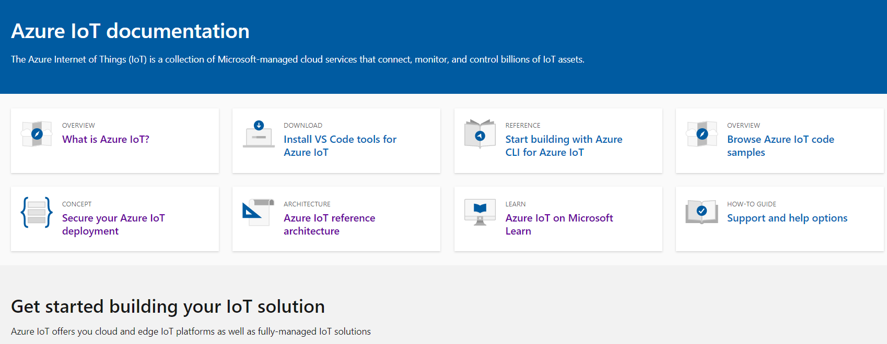
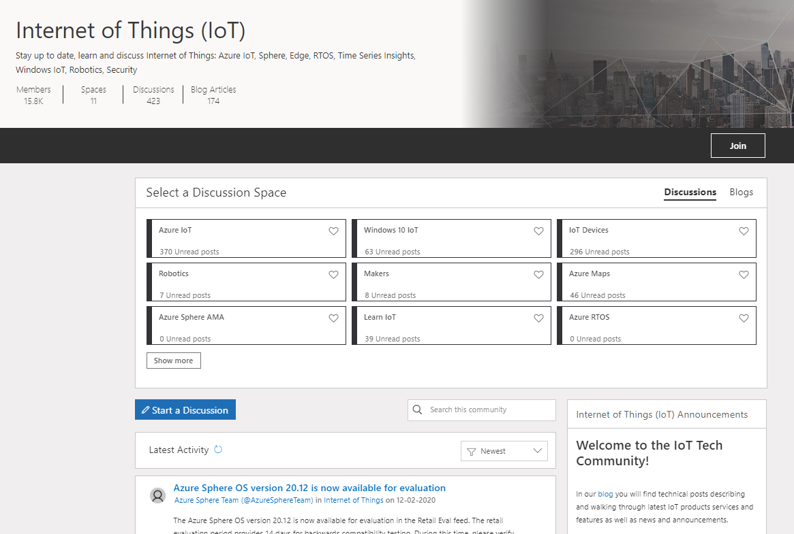
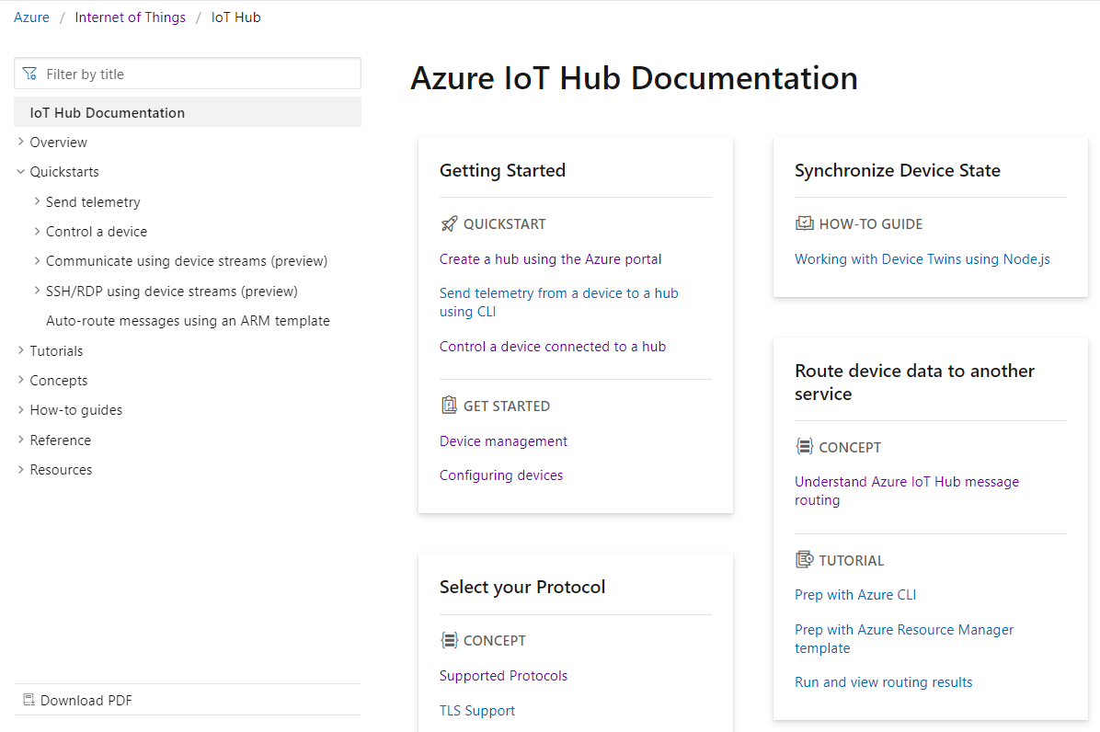

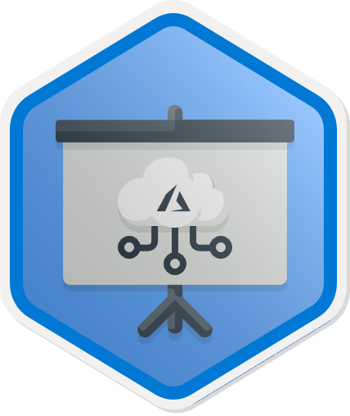
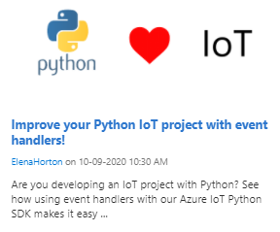
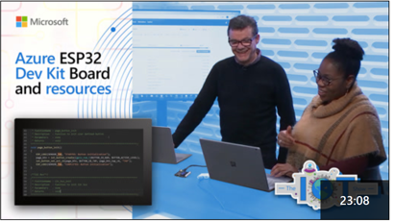
https://aka.ms/get-started-azure-2021
Start upskilling on Azure IoT today!
Hands on Learning | Watch | Discover and Discuss | Get Started Building
Microsoft Learn | Microsoft IoT Developers Channel | IoT Tech Community | Azure IoT Docs
https://aka.ms/mslearniot | https://aka.ms/msiotdevs | https://aka.ms/iottechcommunity | https://docs.microsoft.com/en-us/azure/iot-fundamentals/
MS Learn is the go-to site for self-paced, step-by-step learning. We offer over 40+ individual learn modules covering products such as Azure IoT Hub, IoT Edge, Digital Twins, and more. | Watch and learn about our products! View Deep Dives for deep technical learning. | Check out the blog to find technical posts describing and walking through latest IoT products services and features as well as news and announcements. | Check out the quick starts, how-to guides, and tutorials on Azure IoT Docs to learn how to build your IoT solutions.
https://aka.ms/IntroAzureIoTLearningPath
Notes:
Additionally, MS Learn offers 8 Learning Paths designed to help with certification exam prep as well as deeper concepts targeted at different roles including IoT developer, data engineer, solution architect, and administrator.
ELP videos/presentation decks, MS Learn and Learn Paths, Instructor Led Training options, AZ220 Study Guide blog, IoT Demo GitHub and ultimately encouraging people to sign up for the 30 Days to Learn it challenge to earn 50% off the certification.
Aka.ms/30dayscsc

Slide 23

30 Days to Learn Cloud Skills Challenge
’30 Days to Learn it’ offers a time-bound, personalized, Cloud Skills Challenge that is built upon Microsoft Learn. It is designed to help developers build in-demand skills that advance their career, while preparing them to earn the Microsoft Certification for the Azure IoT Developer (AZ220) exam.
https://aka.ms/30DaysCSC/IoT
Notes:
ELP videos/presentation decks, MS Learn and Learn Paths, Instructor Led Training options, AZ220 Study Guide blog, IoT Demo GitHub and ultimately encouraging people to sign up for the 30 Days to Learn it challenge to earn 50% off the certification.
Aka.ms/30dayscsc

Slide 24
We would love to hear from you! Would you please tell the Azure IoT engineering team about your development processes and tools? By completing this very short (<4 minute) survey? http://aka.ms/EmbeddedDevResearch
Notes:
ELP videos/presentation decks, MS Learn and Learn Paths, Instructor Led Training options, AZ220 Study Guide blog, IoT Demo GitHub and ultimately encouraging people to sign up for the 30 Days to Learn it challenge to earn 50% off the certification.

Slide 25
Live Q&A Thank you! IoT Arch Reference: https://aka.ms/iotrefarchitecture Azure Account Signup: https://aka.ms/get-started-azure-2021 Azure IoT Central: https://apps.azureiotcentral.com/myapps Cloud Skills Challenge: https://aka.ms/30DaysCSC/IoT MS Learn: https://aka.ms/mslearniot MSFT IoT Developer Video Channel: https://aka.ms/msiotdevs IoT Tech Community: https://aka.ms/iottechcommunity Azure IoT Docs: https://docs.microsoft.com/en-us/azure/iot-fundamentals/
Notes:
ELP videos/presentation decks, MS Learn and Learn Paths, Instructor Led Training options, AZ220 Study Guide blog, IoT Demo GitHub and ultimately encouraging people to sign up for the 30 Days to Learn it challenge to earn 50% off the certification.

